Slide 1
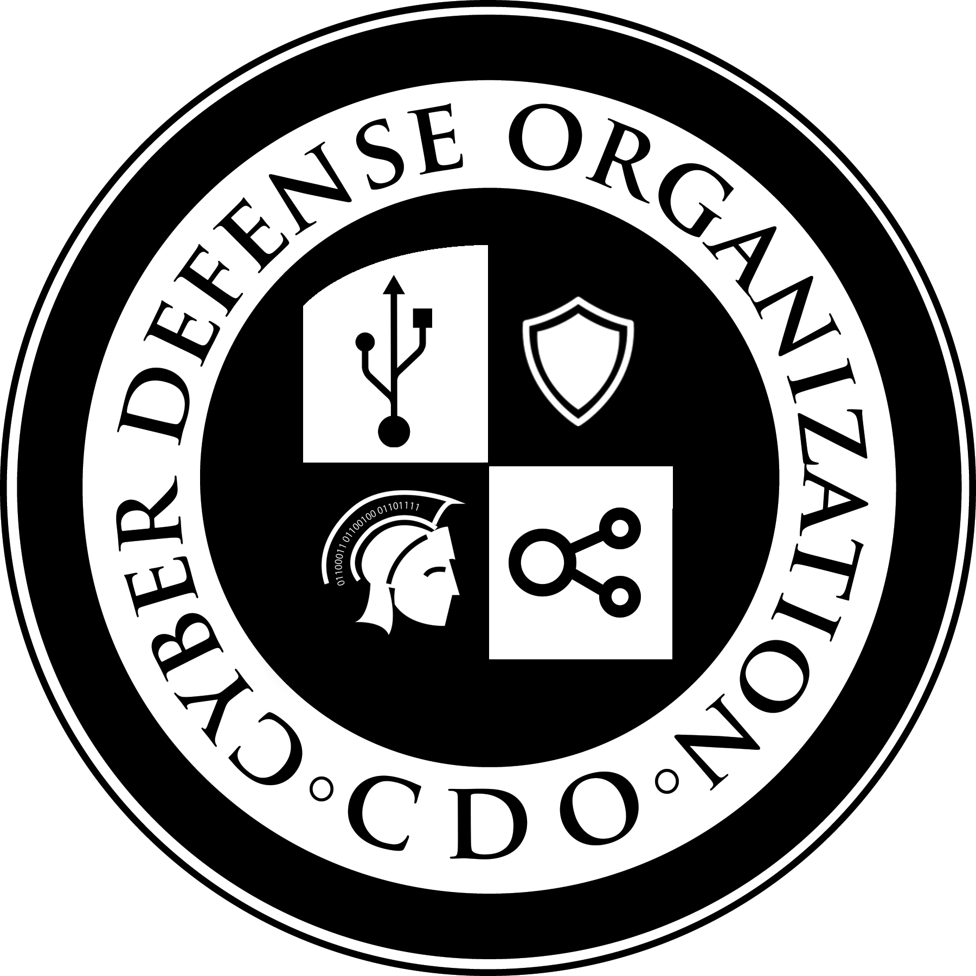
Cyber Defense Organization
Fall 2018 - Intro to InfoSec

Slide 2

Purpose of today
Introduce the basics of Information Security
Semi-Accurate Agenda
Frameworks
Identity and Access Management (IAM)
Authentication
Authorization
Accounting
Introduction to some networking terms
Physical Security
Network Security
Application Security
Technology and Cyber Security Trends
CCDC - Competitions
Questions

Slide 3
Disclaimer
We are students...so yeah.
Fact check us all you want! =)

Slide 4
Why are we doing this?
In order to understand the technical side of all Cyber Security aspects. It’s best to get an idea of the conceptual side of things.
Information Security is massive area one that is constantly changing everyday as new technology is released.
Throughout this semester we intend to slowly introduce you to new topics via lectures and workshops, so that you can become passionate about this field and strive to learn more each day.

Slide 5
Key Definition
Information Security - Information security, sometimes shortened to InfoSec, is the practice of preventing unauthorized access, use, disclosure, disruption, modification, inspection, recording or destruction of information. The information or data may take any form, e.g. electronic or physical.

Slide 6
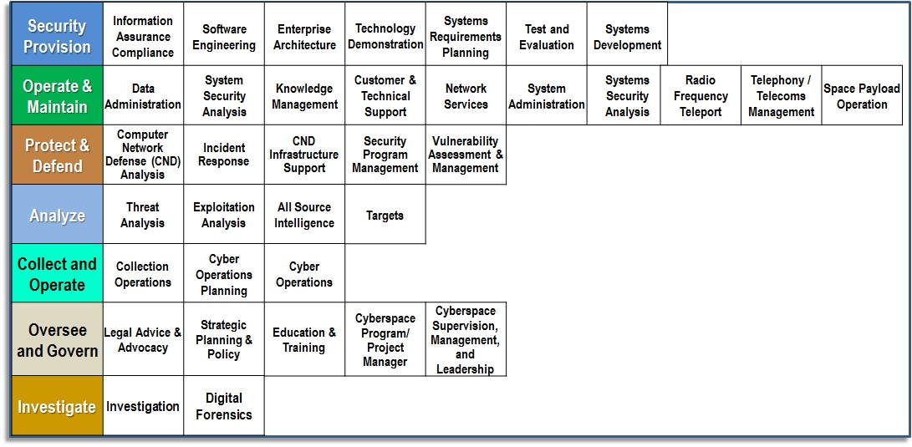

Slide 7
NICE Framework Workforce Categories
Securely Provision (SP) | Conceptualizes, designs, procures, and/or builds secure information technology (IT) systems, with responsibility for aspects of system and/or network development.
Operate and Maintain (OM) | Provides the support, administration, and maintenance necessary to ensure effective and efficient information technology (IT) system performance and security
Oversee and Govern (OV) | Provides leadership, management, direction, or development and advocacy so the organization may effectively conduct cybersecurity work.
Protect and Defend (PR) | Identifies, analyzes, and mitigates threats to internal information technology (IT) systems and/or networks.
Analyze (AN) | Performs highly-specialized review and evaluation of incoming cybersecurity information to determine its usefulness for intelligence
Collect and Operate (CO) | Provides specialized denial and deception operations and collection of cybersecurity information that may be used to develop intelligence.
Investigate (IN) | Investigates cybersecurity events or crimes related to information technology (IT) systems, networks, and digital evidence.

Slide 8
Frameworks
Frameworks allow us to comprehend the massive amount of technology, identify weakness, assess risk, and track progress over time.
NIST Cybersecurity Framework (800-53): Identify, Protect, Detect, Respond, Recover.
ISO 27001 - 14 control categories.
COBIT - Divides enterprise IT into four domains.
Many more, SABSA, TOGAF, ITIL

Slide 9
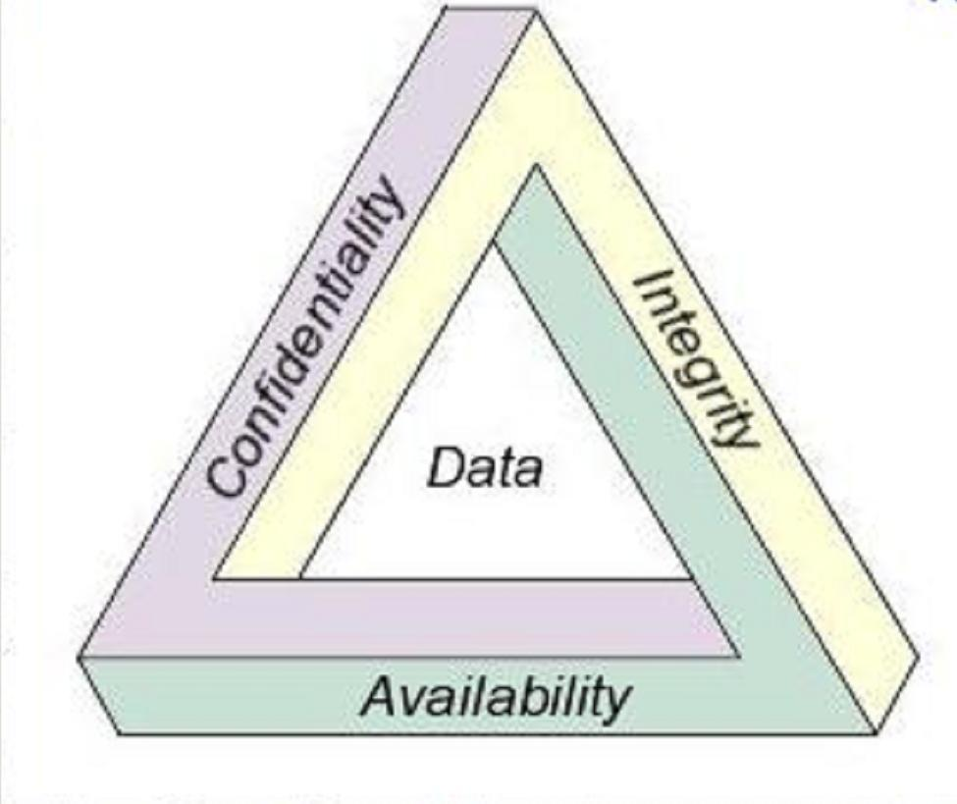

Slide 10
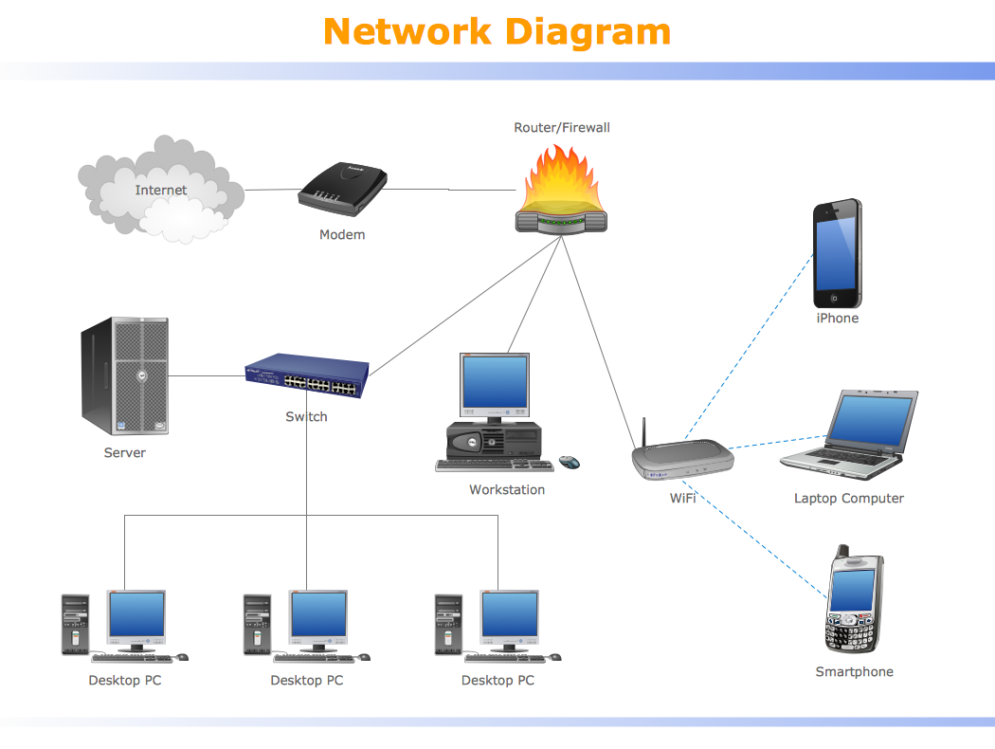
So, what does a network look like?
Users
Endpoints
Servers
Networking Equipment

Slide 11
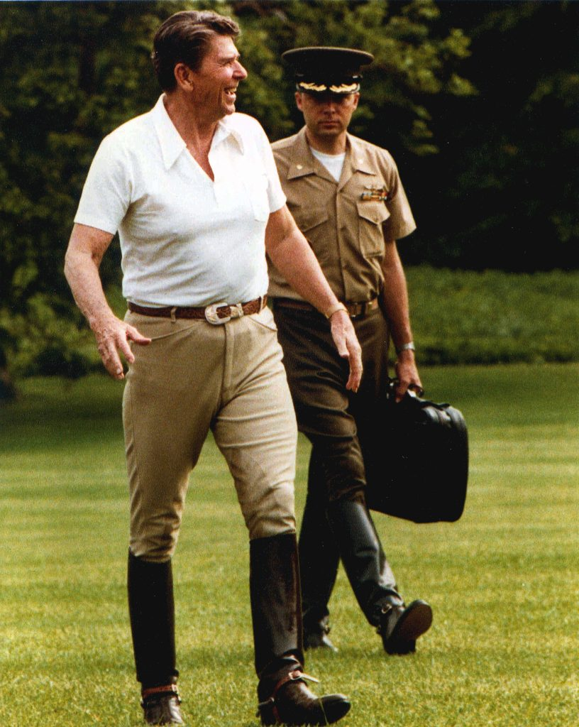
Slight Tangent

Slide 12
Identity and Access Management
Three Parts
Authentication is the process of verifying who you are.
Authorization is the process of verifying that you have access to something.
Accounting is the process of auditing usage post authorization.

Slide 13
Authentication
Three factors:
Something you know.
Something you have.
Something you are.

Slide 14
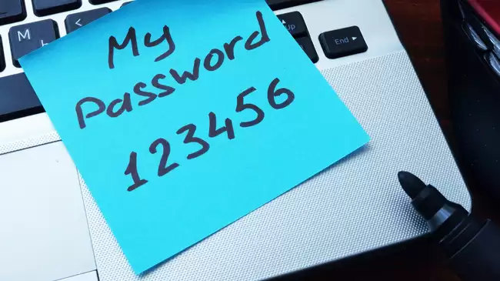
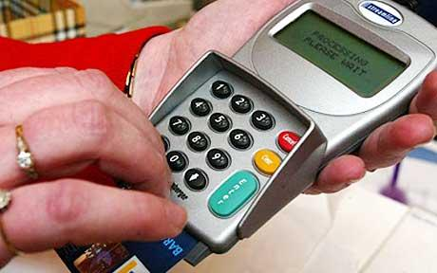
Something you know

Slide 15

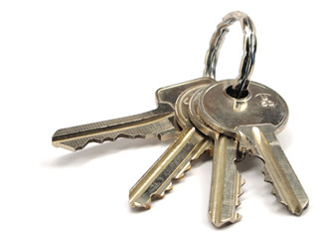
Something you have

Slide 16
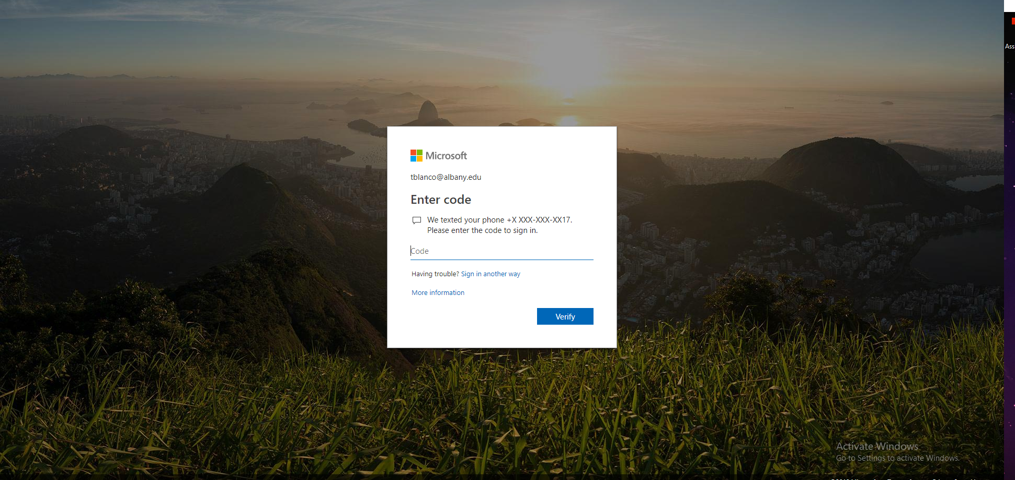

Slide 17

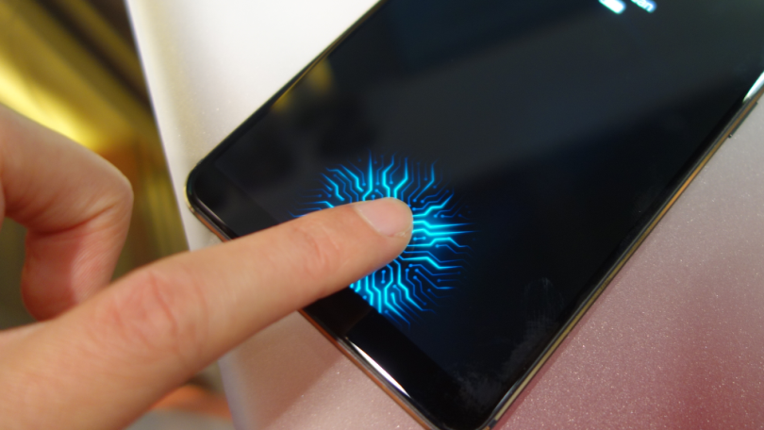
Something you are (Biometrics)

Slide 18
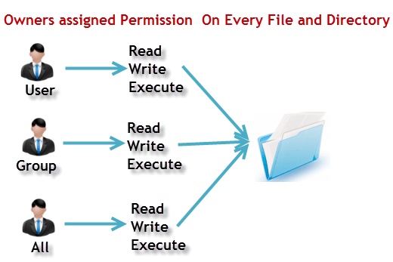
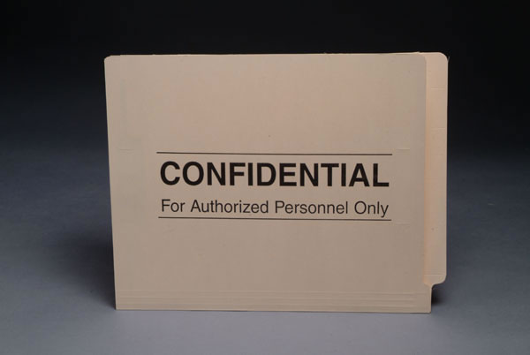
Authorization
Access Control Lists (ACL). Who is allowed to open or edit a file?

Slide 19
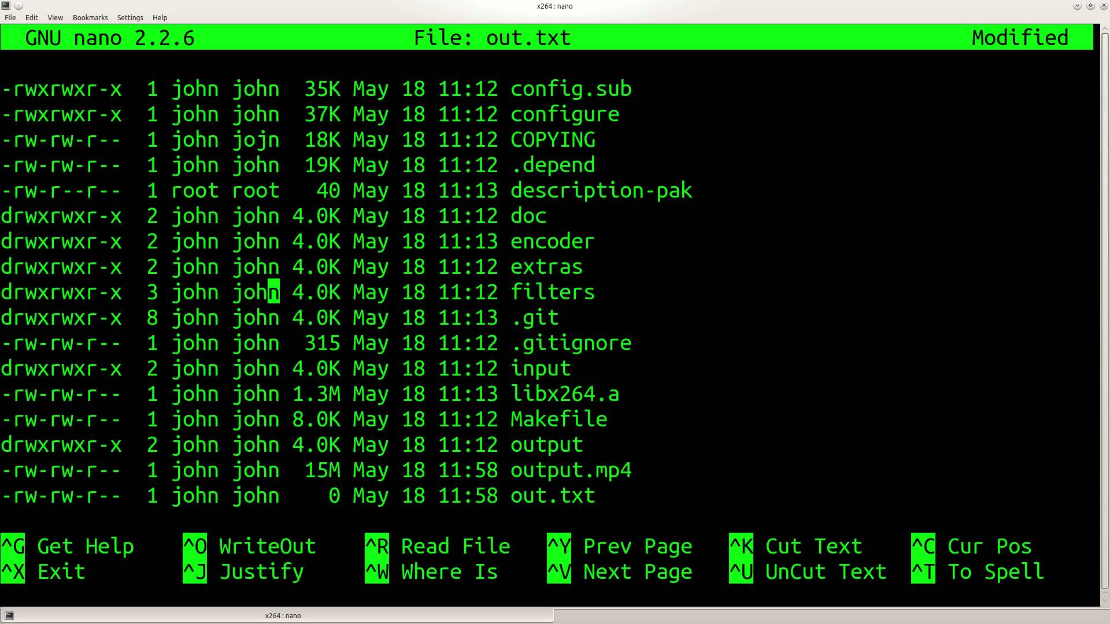

Slide 20
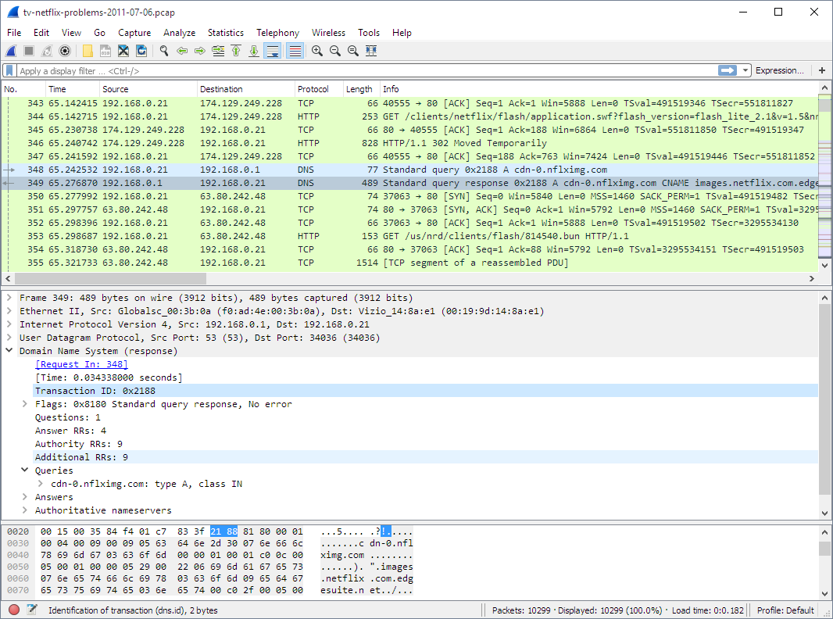
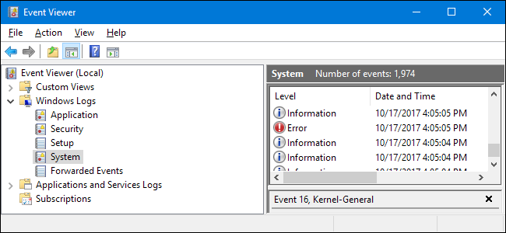
Accounting

Slide 21
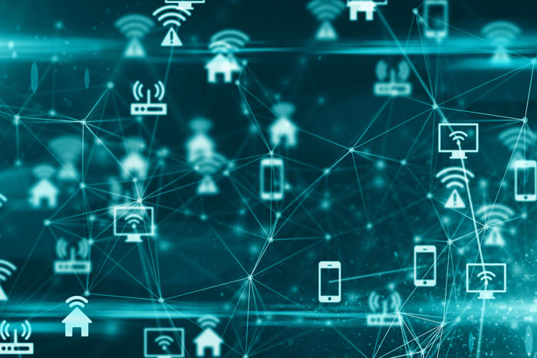
Networking
Router
Switch
Hub
DHCP - Gives you IP Address
DNS - Gives you other IPs
ARP
IP Address
Subnet mask

Slide 22
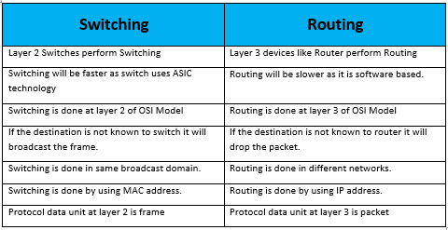
Networking

Slide 23

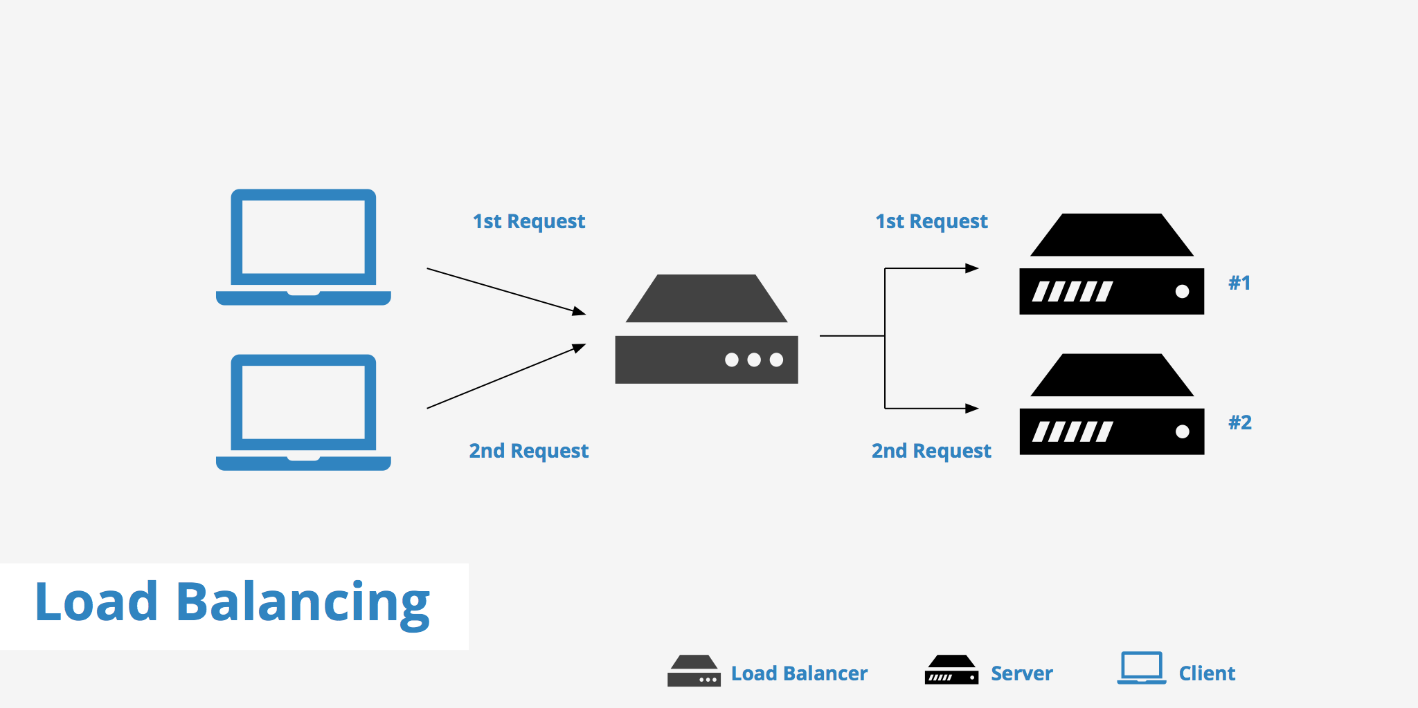
Network Security
VPN
NIDS and NIPS
Security information and event management (SIEM)
Honeypots

Slide 24

NIDS (Passive)

Slide 25
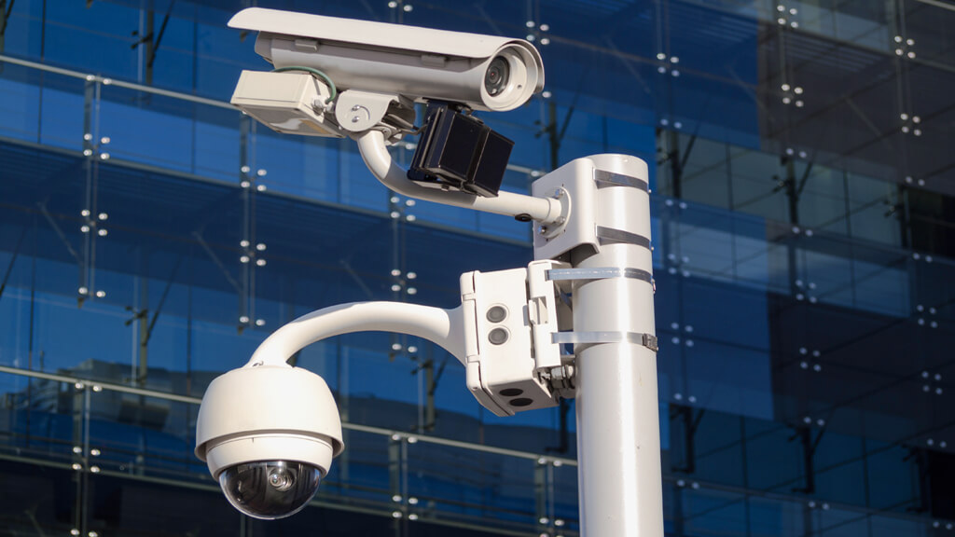
Physical Security
Lighting
Signs
Fencing/gate/cage
Security guards
Alarms
Secure cabinets/enclosures
CCTV

Slide 26
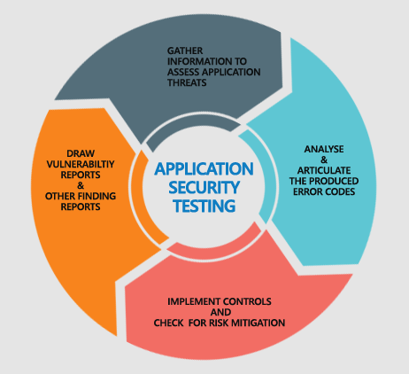
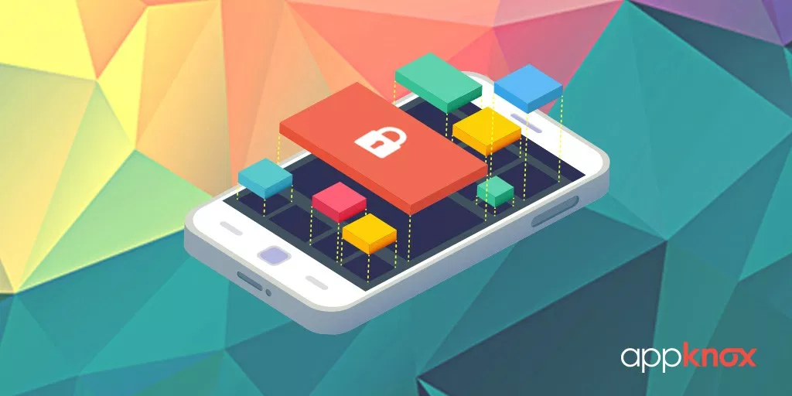
Application Security
Proper error handling
Proper input validation
Stress testing
Version control and change management

Slide 27
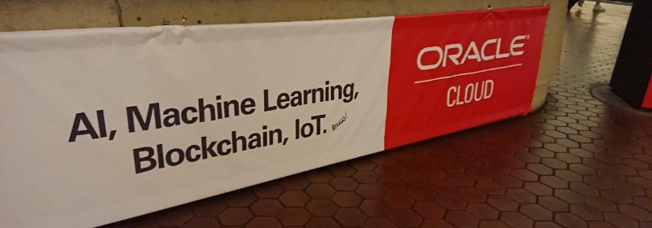
Technology and CyberSecurity Trends

Slide 28
The Trends (kinda in order of hype)
Block chain
Artificial Intelligence
Machine Learning
Internet of Things (IoT)
Bring Your Own Device (BYOD)
Cloud
Zero Trust Network

Slide 29
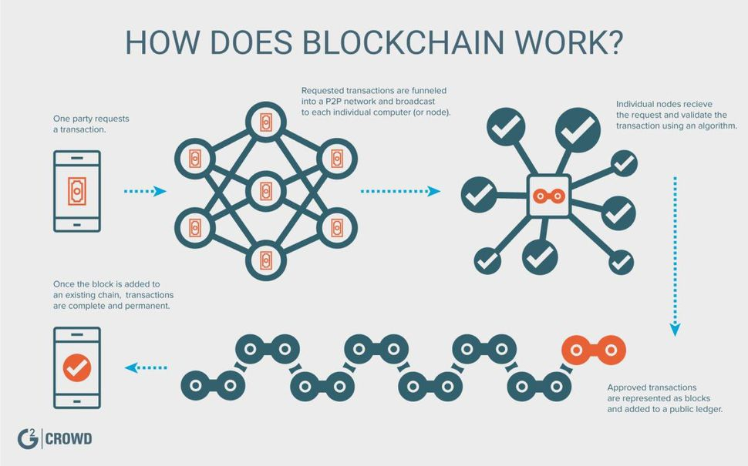
Block Chain
Remember the CIA triad?
Blockchain only cares about integrity. It is a network where transactions (records) are put on a public ledger that all members of the network must agree to.
It is a zero trust environment. It is slow.
It is not magic. It is not the solution to everything.
But it is pretty neat.

Slide 30

Artificial Intelligence
AI is a broad term, basically anytime a computer is tasked to make a choice, or evaluation.
Computers don't have to be perfect, all they need to be is better than people.

Slide 31
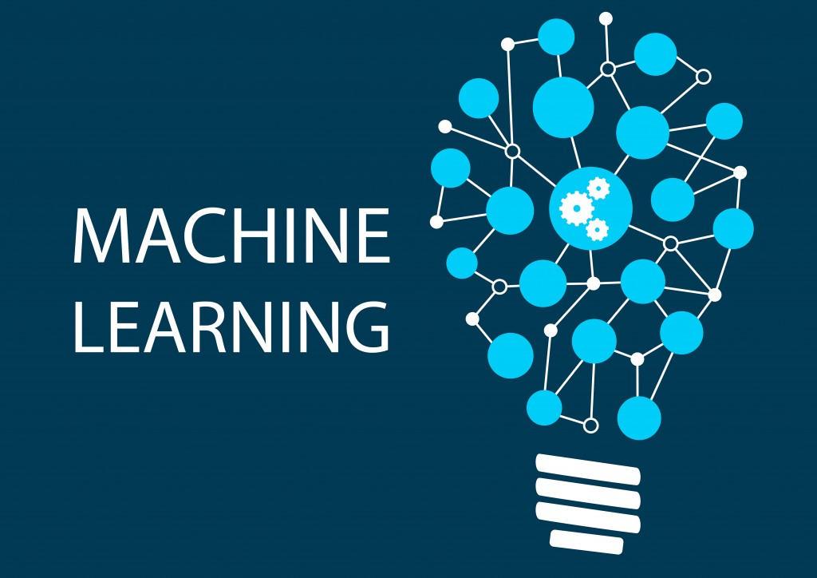
Machine Learning
Building good AI is really hard.
Really hard.
So why not just have machines to it themselves?
How Machines Learn - https://www.youtube.com/watch?v=R9OHn5ZF4Uo
TL;DR you have Builder bots, and Tester bots. (This is why we need so much data).

Slide 32

Internet of Things
The Internet of Things, commonly abbreviated as IoT, refers to the connection of devices (other than typical fare such as computers and smartphones) to the Internet.
Why do we care?
Built as cheaply as possible.
Are everywhere.

Slide 33

Bring Your Own Device (BYOD)
Most businesses nowadays allow employees to connect their own devices to the networks
Privacy vs security
Most employees do not want their every move on their personal devices to be monitored
However, it is harder to secure something if you cannot fully monitor it

Slide 34

Cloud
Applications went from:
Pets - Your own personal machine.
Cattle - Mostly reproducible environments, often in the cloud.
Cells - Very small servers that exist for as short as needed.
https://www.slideshare.net/shivamaan/pets-cattle-rabbits-and-microbes

Slide 35
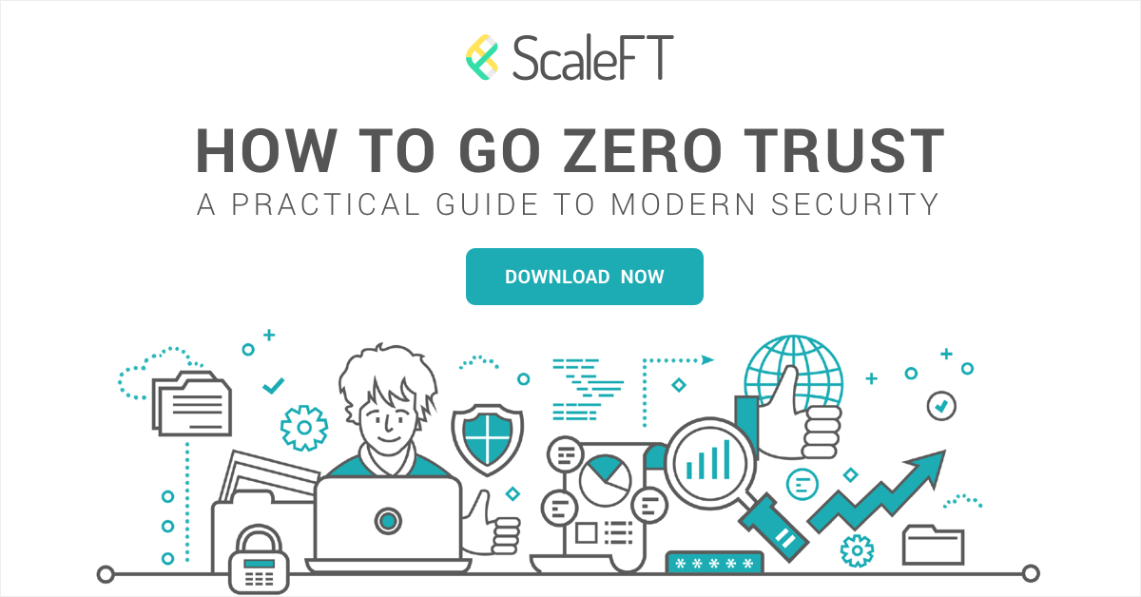
Zero Trust Networks / Software Defined Perimeter
Network security model
Strict policies
No traffic is trusted
Minimum needed permissions
Why?

Slide 36
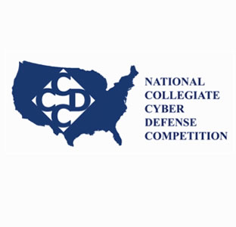
CCDC Team Selection
Join the Geek Side
What We Look For:
Communication & Collaboration
Strong Work Ethic
Writing Skills
Personal Integrity
Prior cyber defense experience is a bonus, but not required
How Do I Join?
Phase 1: Apply! Send your resume and a writing sample to mlim@albany.edu
You can use something you’ve already written for the writing sample
Phase 2: Interview with Team Captain (I won’t polygraph you, pinkie promise.)
Phase 3: Interview with current team members (see if you like us!)

Slide 37

CCDC Workshops (Dates TBA)
“I’m unable to join the team. Can I still come to workshops?” YES!!
What We’ll Do (Tentative, always open to new ideas!)
UBNetDef Lockdown
https://lockdown.ubnetdef.org/about/
Cyber Defense Learning (like lectures, but we’re all clueless. Sort of.)
https://ubnetdef.org/lectures/
NSA Codebreaker Challenge (learn to hack the NSA. Kidding.)
https://codebreaker.ltsnet.net/challenge
What You’ll Get
Cyber Defense Knowledge & Skills -- We train you!
Potential for Competition Experience (UBNetDef Lockdown)
(Not after season 3)

Slide 38




Cya Next week!
Send your resume and a writing sample to mlim@albany.edu
Follow us on Twitter? Add on myInvolvement?
Guest speaker, Brian Dow from DASNY - Tuesday 7:15pm BB129
Top 20 CIS Controls Thursday 7:30pm BB121
Introduction to Windows Security
- Friday 3pm BB123

